Slide 1
QUALITATIE ANALYSIS OF ORGANIC COMPOUMDS

Slide 2
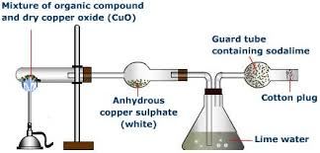
DETECTION OF CARBON AND HYDROGEN

Slide 3
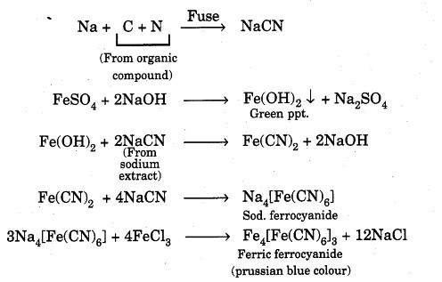
DETECTION OF NITROGEN

Slide 4
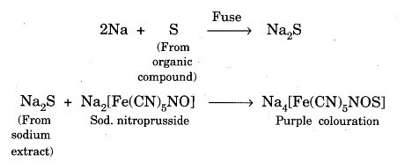
TEST FOR SULPHUR

Slide 5
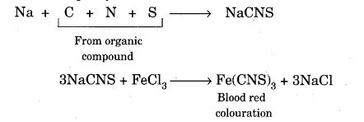
TEST FOR THIOCYNATE

Slide 6
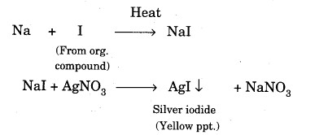
TEST FOR HALOGEN

Slide 7
TEST FOR PHOSPHOROUS

